Slide 1

Company Funding and Startup Success
TESTING MY PRECONCEPTIONS AND PREDICTING STARTUP SUCCESS
Notes:
Hi guys! This is my project presentation about Company Funding and Startup Success.

Slide 2

Presentation Guide
TOPIC OUTLINE
1. Company Funding Analysis
2. Model to Predict Startup Success
Startups and Company Funding Analysis
Notes:
In terms of the outline, I’ll divide this presentation in 2 different groups, which are the analysis of company funding and then the model to try and predict startup success.

Slide 3

COMPANYFUNDING
Notes:
So, we'll got straight into this, and I’ll start off with my company funding analysis, with the help of a great database which has the funding divided into categories for more than thirty thousand companies all over the world.

Slide 4


DEBT FINANCING
Bank loans and similar mechanisms
ALTERNATIVE FUNDING
Business angels,equity crowdfunding, product crowdfunding, seed money and venture capital
Notes:
First of all, so we are all on the same boat with the concepts, I divided company funding in two large groups: debt financing (which are basically loans of all kinds), and ‘alternative funding’ in which I include mechanisms like crowdfuning, business angels and venture capitalists. And I will actually use the term alternative funding in the analysis, so I’m just refering to this.

Slide 5

TESTED PRECONCEPTION
Newer companies have higher values of ‘alternative’ funding due to its increasing popularity and the dynamism of the startup ecosystem.
Notes:
So I wanted to test one of my personal preconcenptions, as a consultant, which is: Newer companies have higher values of alternative funding due to its increasing popularity and the dynamism of the startup ecosystem.
So what this means is I believe that this alternative funding (business angels, venture capitalists, crowdfunding) is more popular between newer companies than older companies.

Slide 6
21st
20th
CENTURY COMPANIES
CENTURY COMPANIES
Notes:
In order to do this I split my database in companies from the 21st century and 20th century and the analysis will be performed between these two groups.

Slide 7

1st ANALYSIS
95% CONFIDENCE INTERVAL FOR THE DIFFERENCE OF ‘ALTERNATIVE’ FUNDING, CONSIDERING THE AVERAGE FUNDING PER YEAR
21ST CENTURY - 20TH CENTURY
Notes:
In order to do this, I built a 95% confidence interval for the difference of this ‘alternative funding’ per year of operation of the company between 21st century and 20th century companies.

Slide 8
1st ANALYSIS
95% CONFIDENCE INTERVAL FOR THE DIFFERENCE OF ’ALTERNATIVE’ FUNDING, CONSIDERING THE AVERAGE FUNDING PER YEAR
21ST CENTURY - 20TH CENTURY
[151991, 249108]
Notes:
So, comparing to 20th century companies, the 21st century companies do have more of this ‘alternative’ type of funding (since my confidence interval return positive results) with the values of the difference being between one hundred and fifty two thousand dollars and two hundred and forty nine thousand dollars.

Slide 9
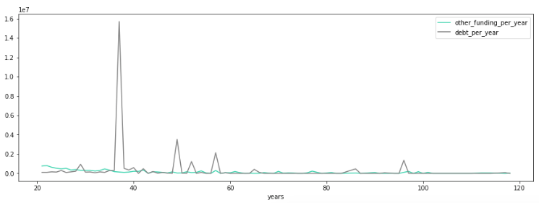
2nd ANALYSIS
COMPARING ‘ALTERNATIVE’ FUNDING WITH DEBT FINANCING IN 21ST CENTURY COMPANIES VS 20TH CENTURY COMPANIES
alternative funding per year
debt per year
20TH CENTURY
Notes:
Just to finish off my analysis, i computed graphically the two lines of debt financing and alternative funding per year. And with companies from the 20th century we can see that there is no clear difference between the two.

Slide 10
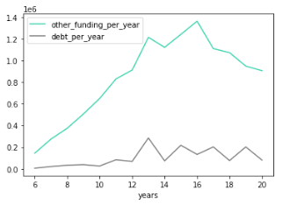
2nd ANALYSIS
COMPARING ’ALTERNATIVE’ FUNDING WITH DEBT FINANCING IN 21ST CENTURY COMPANIES VS 20TH CENTURY COMPANIES
alternative funding per year
debt per year
21ST CENTURY
Notes:
So, now that I know that 21st century companies to have more of this alternative funding, I went ahead and computed the difference between alternative funding and debt financing per year, in which we can clearly see a tendency for more alternative funding than debt financing in newer companies.
So, in terms of conclusion what i now know is that this alternative funding is more popular than debt for newer companies, and newer companies do seem to have more seed, venture capital and crowdfunding.

Slide 11

Predicting Startup Success
Notes:
So, now that my Funding Analysis in complete, I’ll go into the model of predicting startup success.

Slide 12


DATABASE
473
Startups with status of Failed or Success
115
Variables
41 - numerical
74 - categorical
Notes:
In order to this, I had a databse with four hundred and seventy three startups with the status of failed or success and one hundred and fifteen variables.

Slide 13
Robert Lussier studies - explanatory variables
FOUNDER
MARKET
STARTUP
Industry Experience
Management Experience
Education
Age
Parents
Minority
Marketing
Product/Service Timing
Economic Timing
Record keeping and financial control
Capital
Planning
Professional Advisors
Staffing
Notes:
Before starting, and because preconceptions are not always right, I dived into the literature of what is needed for a startup to succeed. And I based my model into Robert Lusssier studies, which isolated the explanatory variables for startup success. Here, I just showcase those variables, grouped by its category whether they are about the founder, the market or the startup itself. So, these are the theoretical variables that explain startup success.

Slide 14
Database variables
FOUNDER
MARKET
STARTUP
Worked in top companies
Part of startups in the past
Part of successful startups in the past
Partner in big5
Consulting experience
Years of education
Relevance of education
Relevance of experience
Breadth of experience across verticals
Experience in building and selling products
Hype Cycle stage
Target (B2C or B2B)
Market size (local or global)
Disruptiveness of technology
# employees
# co-founders
# advisors
# senior leaders
# investors in seed
# angel and VC investors
# repeat investors
Pricing strategy
Company awards
Difficulty obtaining workforce
Notes:
After that, i used my database to try and find similar variables to those of Robert’s studies and this is what i came up with.

Slide 15



Building Logistic Regression
PREPARE DATA
TRAIN DATASET
FIT MODEL TO LOGISTIC REGRESSION
sklearn.linear model
Notes:
And now to the easy part, which was building the model. I had to use a binary logistic regression since my output was categorical. To do this, i prepared and cleaned the dataset. After that, and in order to understand model performance, i divided the dataset into a training set and a test set. Here I broke it into two parts in a ratio of 75 to 25. In the end, I just fit the model on the train set.

Slide 16
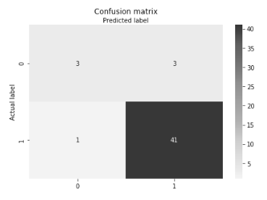



My Results
Accuracy
91,67%
Recall
97,61%
Precision
93,18%
Notes:
I was actually happy with my results. If we start with the confusion matrix, we see that 41 and 3 are actual predictions while 3 and one are incorrect predictions. What i can also see is that my data is a bit unbalanced, since I hade much more successful startups than failed ones after I cleaned the data. I also see that my model is better at predicting success than failure. Regarding the indicators, I got that my model is 91,67% accurate. About the recall, it means that if there are successful startups in the test set my Logistic Regression model can identify it 97,61% of the time. About the precision, it means that, when my model predicts a successful startup, 93,18% will actually be.
Besides that, my model results were inline with other models built upon Robert's studies.

Slide 17
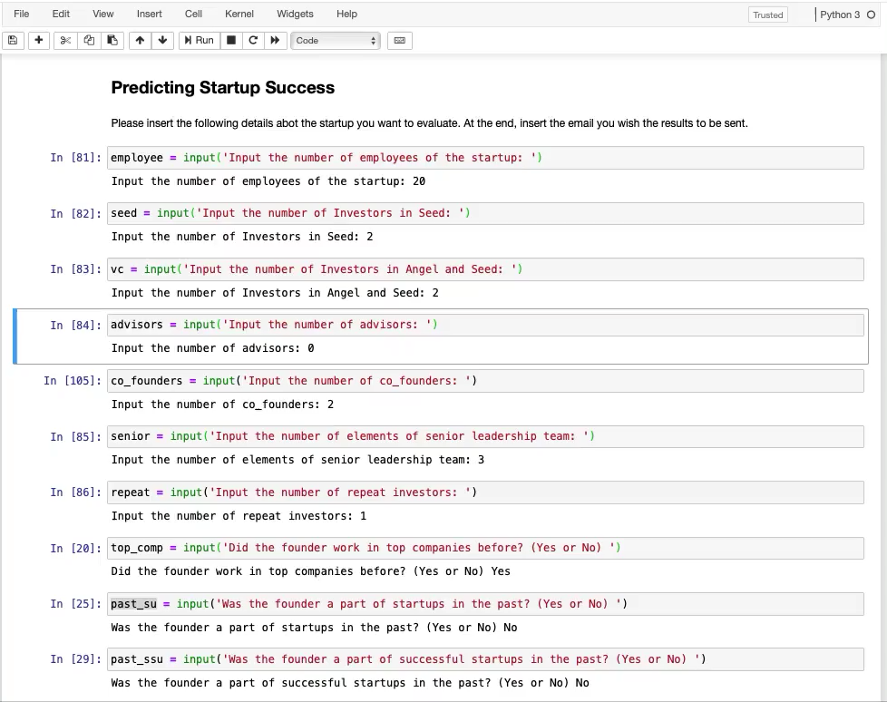



Practical Use
Fill survey about startup
Get results by email
Graphically analyze database

Slide 18
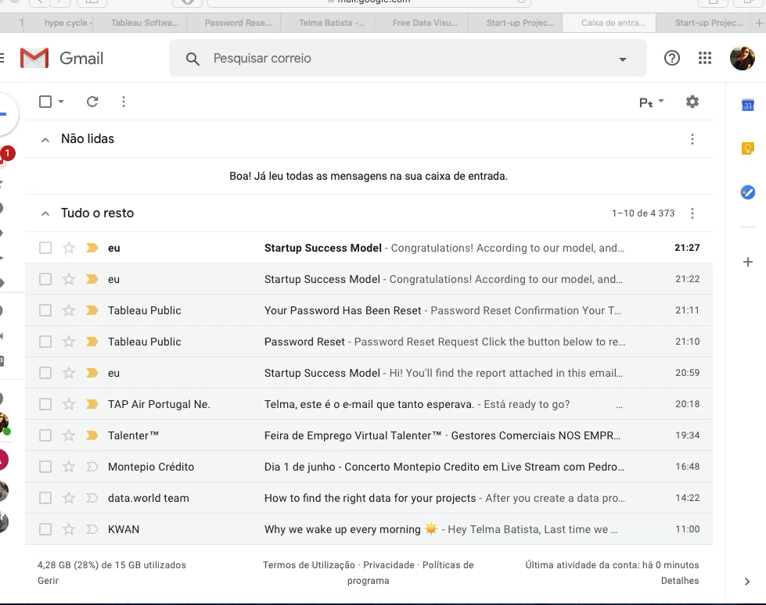
Practical Use
Get results by email

Slide 19
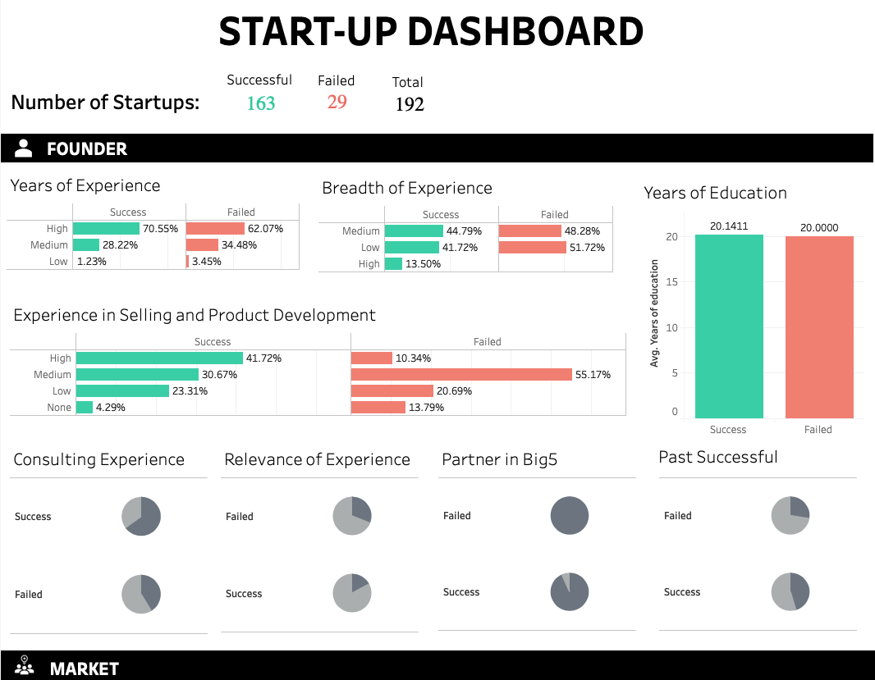
Practical Use
Graphically analyze database

Slide 20

Thank you!

